Slide 1

Healthcare Provider Fraud Detection Using Machine Learning
DataOrbit - Medicare Claims Analysis Project
Machine Learning, Winter 2025
German International University

Slide 2

The Healthcare Fraud Crisis & Our Mission
The Problem
Our Mission
$68 BILLION
Healthcare fraud costs the U.S. healthcare system over $68 billion annually
Build a data-driven ML model to identify high-risk fraudulent providers
Handle severe class imbalance (approximately 10% fraud rate)
Medicare can only investigate a small fraction of suspicious cases
Provide explainable predictions and minimize false positives
Current rule-based systems miss sophisticated fraud schemes
Annual Healthcare Fraud Cost
Transform from random sampling to intelligent, targeted fraud detection
Common Fraud Types
Billing for unrendered services, Upcoding, Unbundling, Claims for deceased patients, Unnecessary treatments, Kickback schemes

Slide 3
Dataset: Foundation of Our Analysis
4 Data Sources
Train_Beneficiarydata.csv - Patient demographics, coverage, chronic conditions
Train_Inpatientdata.csv - Hospital admission claims with financial details
Train_Outpatientdata.csv - Outpatient claim data (visits, tests, procedures)
Train_Labels.csv - Provider-level fraud labels (Yes or No)
Dataset Scale
5,410
506 (9.4%)
4,904 (90.6%)
Class Imbalance Challenge
This represents a significant challenge for model training.
Total Providers
Legitimate Providers
Fraudulent Providers

Slide 4
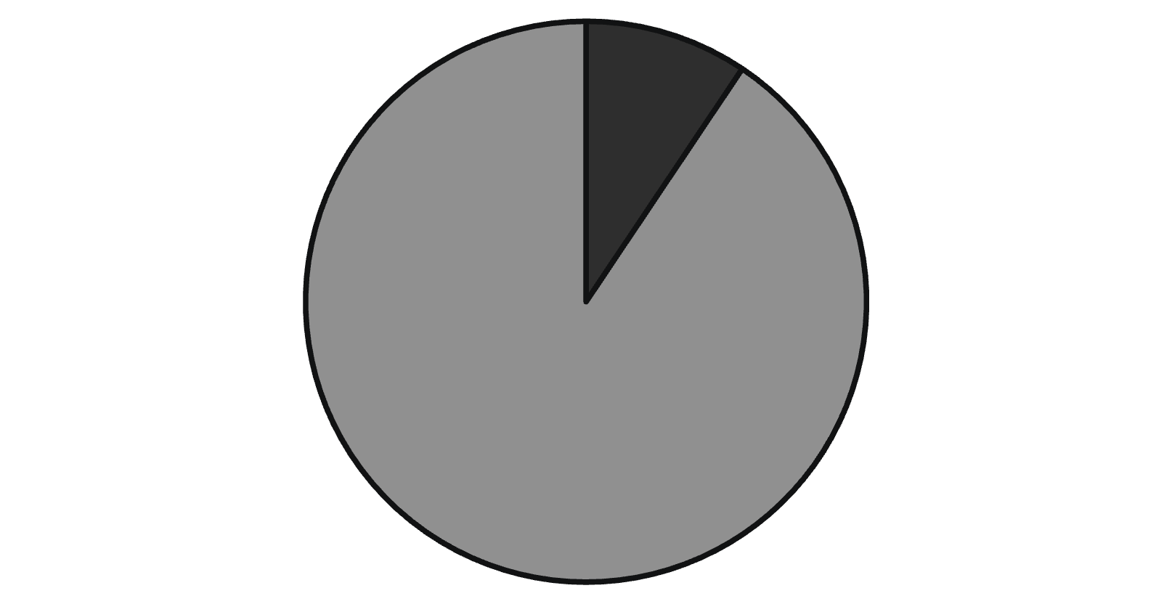
Key Identifiers
BeneID: Links patients to claims
Provider: Links claims to fraud labels
Fraudulent
Legitimate
Distribution of fraudulent vs. legitimate providers.

Slide 5
Methodology: Features & Model Selection
Feature Engineering
68 Engineered Features Across 5 Categories:
Financial: Total/average reimbursement amounts, deductibles
Volume: Total claims, unique beneficiaries, inpatient/outpatient ratios
Demographics: Average patient age, unique beneficiary count
Medical Complexity: Diagnoses/procedures, chronic conditions, length of stay
Temporal: Claim durations, visit patterns
Class Imbalance Strategy
Handling Severe Class Imbalance
Tested: Class weights, SMOTE, Oversampling, Undersampling
Selected: Class weighting (avoids synthetic noise, best performance)

Slide 6
Model Selection
3 Models Evaluated:
Logistic Regression - Baseline for interpretability
Random Forest - Robust ensemble (100 trees)
XGBoost - High-performance gradient boosting ⭐ SELECTED
Validation: 5-Fold Stratified Cross-Validation + 20% hold-out test set

Slide 7
Final Model Performance: XGBoost Results
64.6%
72.3%
68.2%
0.961
Precision
Recall
F1-Score
ROC-AUC
64.6% of flagged providers are actually fraudulent
catches 72.3% of all fraudulent providers
balanced performance metric
excellent discrimination - 96.1%
0.795
PR-AUC
strong precision-recall trade-off

Slide 8
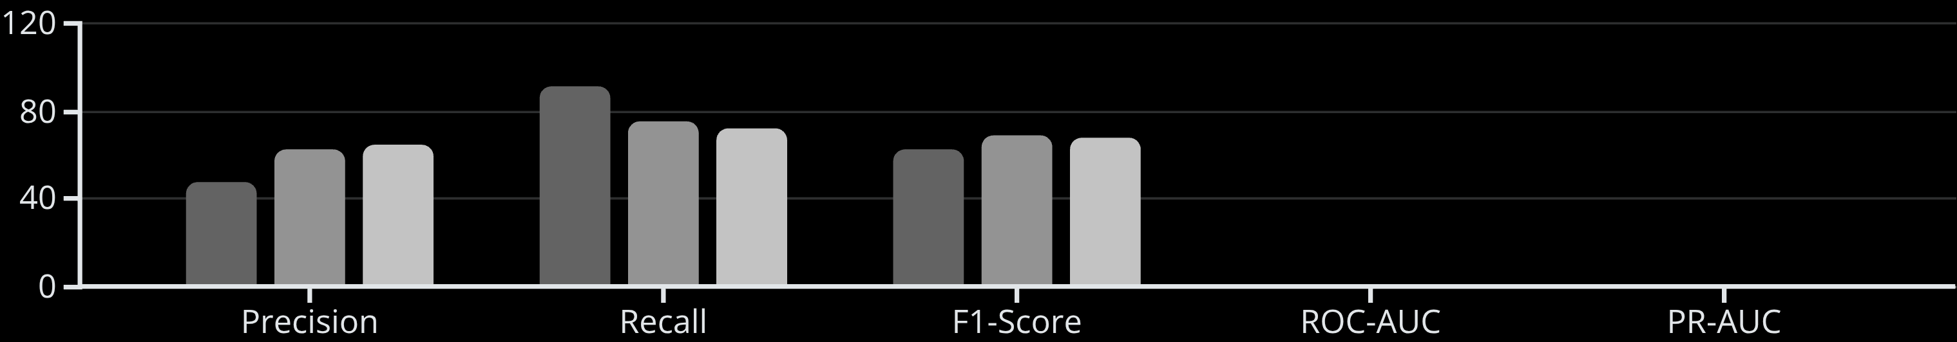
Model Comparison Table
Model
Precision
Recall
F1
ROC-AUC
PR-AUC
Logistic Regression
47.7%
91.1%
62.6%
0.968
0.784
Random Forest
62.8%
75.2%
68.5%
0.967
0.764
XGBoost
64.6%
72.3%
68.2%
0.961
0.795 ⭐
Model Performance Comparison
Logistic Regression
Random Forest
XGBoost

Slide 9
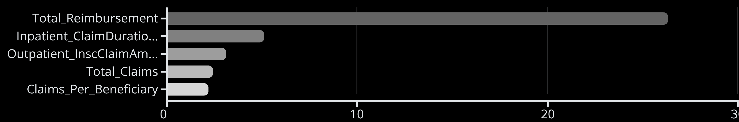
What Makes a Provider High-Risk? Key Fraud Indicators
Top 5 Fraud Indicators (XGBoost Feature Importance):
Total_Reimbursement - 26.3% (Unusually high total billing)
Inpatient_ClaimDuration_max - 5.1% (Extended claim processing times)
Outpatient_InscClaimAmtReimbursed_sum - 3.1% (High outpatient billing)
Total_Claims - 2.4% (Unusually high claim volume)
Claims_Per_Beneficiary - 2.2% (Excessive claims per patient)
Key Insight: Financial features (especially total reimbursement) are the strongest fraud signals. Inpatient patterns are stronger predictors than outpatient.

Slide 10
Understanding Model Limitations: Error Analysis
False Positives: 40 cases (4.08% of legitimate providers)
False Negatives: 28 cases (27.72% of fraudulent providers)
Characteristics: High-volume legitimate providers, specialists, teaching hospitals
Characteristics: Sophisticated fraudsters, low-volume fraud
Business Impact: Continued fraud losses, missed fraudulent activity
Business Impact: Unnecessary investigations, wasted resources
Mitigation: Temporal features, network analysis, cost-sensitive learning
Mitigation: Two-stage review, probability-based prioritization
Confusion Matrix Breakdown
72
940
40
28
True Positives
True Negatives
False Positives
False Negatives

Slide 11
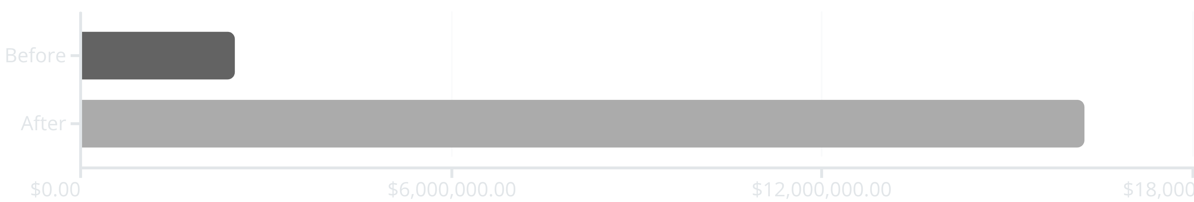
Real-World Value: Business Impact & ROI
Current State (Without Model)
With XGBoost Model
Random sampling: ~5% of providers reviewed monthly
Targeted review: Top 10% highest-risk providers
Detection rate: ~10% (baseline fraud rate)
Detection rate: 60-70% of reviewed cases are fraud (6-7x improvement)
Monthly recovery: $2.5 million
Monthly recovery: $15-17.5 million
Net Benefit: $12.5-15 million per month
ROI: 500-600% increase in fraud detection
$12.5-15M
Deployment: Monthly scoring, tiered alerts, SHAP explanations, quarterly retraining

Slide 12
Explainability & Future Enhancements
Why We Can Trust This Model
SHAP Analysis: Instance-level explanations for each prediction
Feature Importance: Clear understanding of what drives predictions
Human-in-the-Loop: Final determination by investigators, not algorithm
Transparency: All decisions logged, fairness monitoring, explainable for compliance
Future Enhancements
Temporal features: Detect sudden behavior changes
External data sources: Provider credentials, sanctions lists
Specialty-specific models: Tailored detection for different provider types
Success Metrics
>50%
<40%
>4/5
Detection rate
False positive rate
Investigator satisfaction

Slide 13
Conclusion: Key Achievements
Successfully Developed ML Solution
72.3%
64.6%
0.961
0.795
Recall
Precision
ROC-AUC
PR-AUC
✅ Business Value
$12.5-15M monthly benefit through targeted investigations
500-600% ROI improvement
Explainable predictions enable investigator trust
Ready for deployment with proper infrastructure
✅ Key Achievement
This solution transforms fraud detection from reactive random sampling to proactive, intelligent prioritization, potentially saving billions annually.
The XGBoost model successfully identifies fraudulent providers based on billing patterns, with clear business justification and explainable predictions.

